Slide 1
CUSTOMER SHOPPING BEHAVIOR
What 3,900 purchases reveal
Revenue, loyalty, product demand, and the next growth moves.

Slide 2
THE BASE
3,900 purchases
Analysis spans 18 fields across demographics, products, promotions, shipping, and purchase frequency.
3,116 loyal customers
80% of the customer segments are classified as Loyal.
27% subscribed
Large.
Loyal.
Under-subscribed.
1,053 customers are subscribers; 2,847 are not.

Slide 3
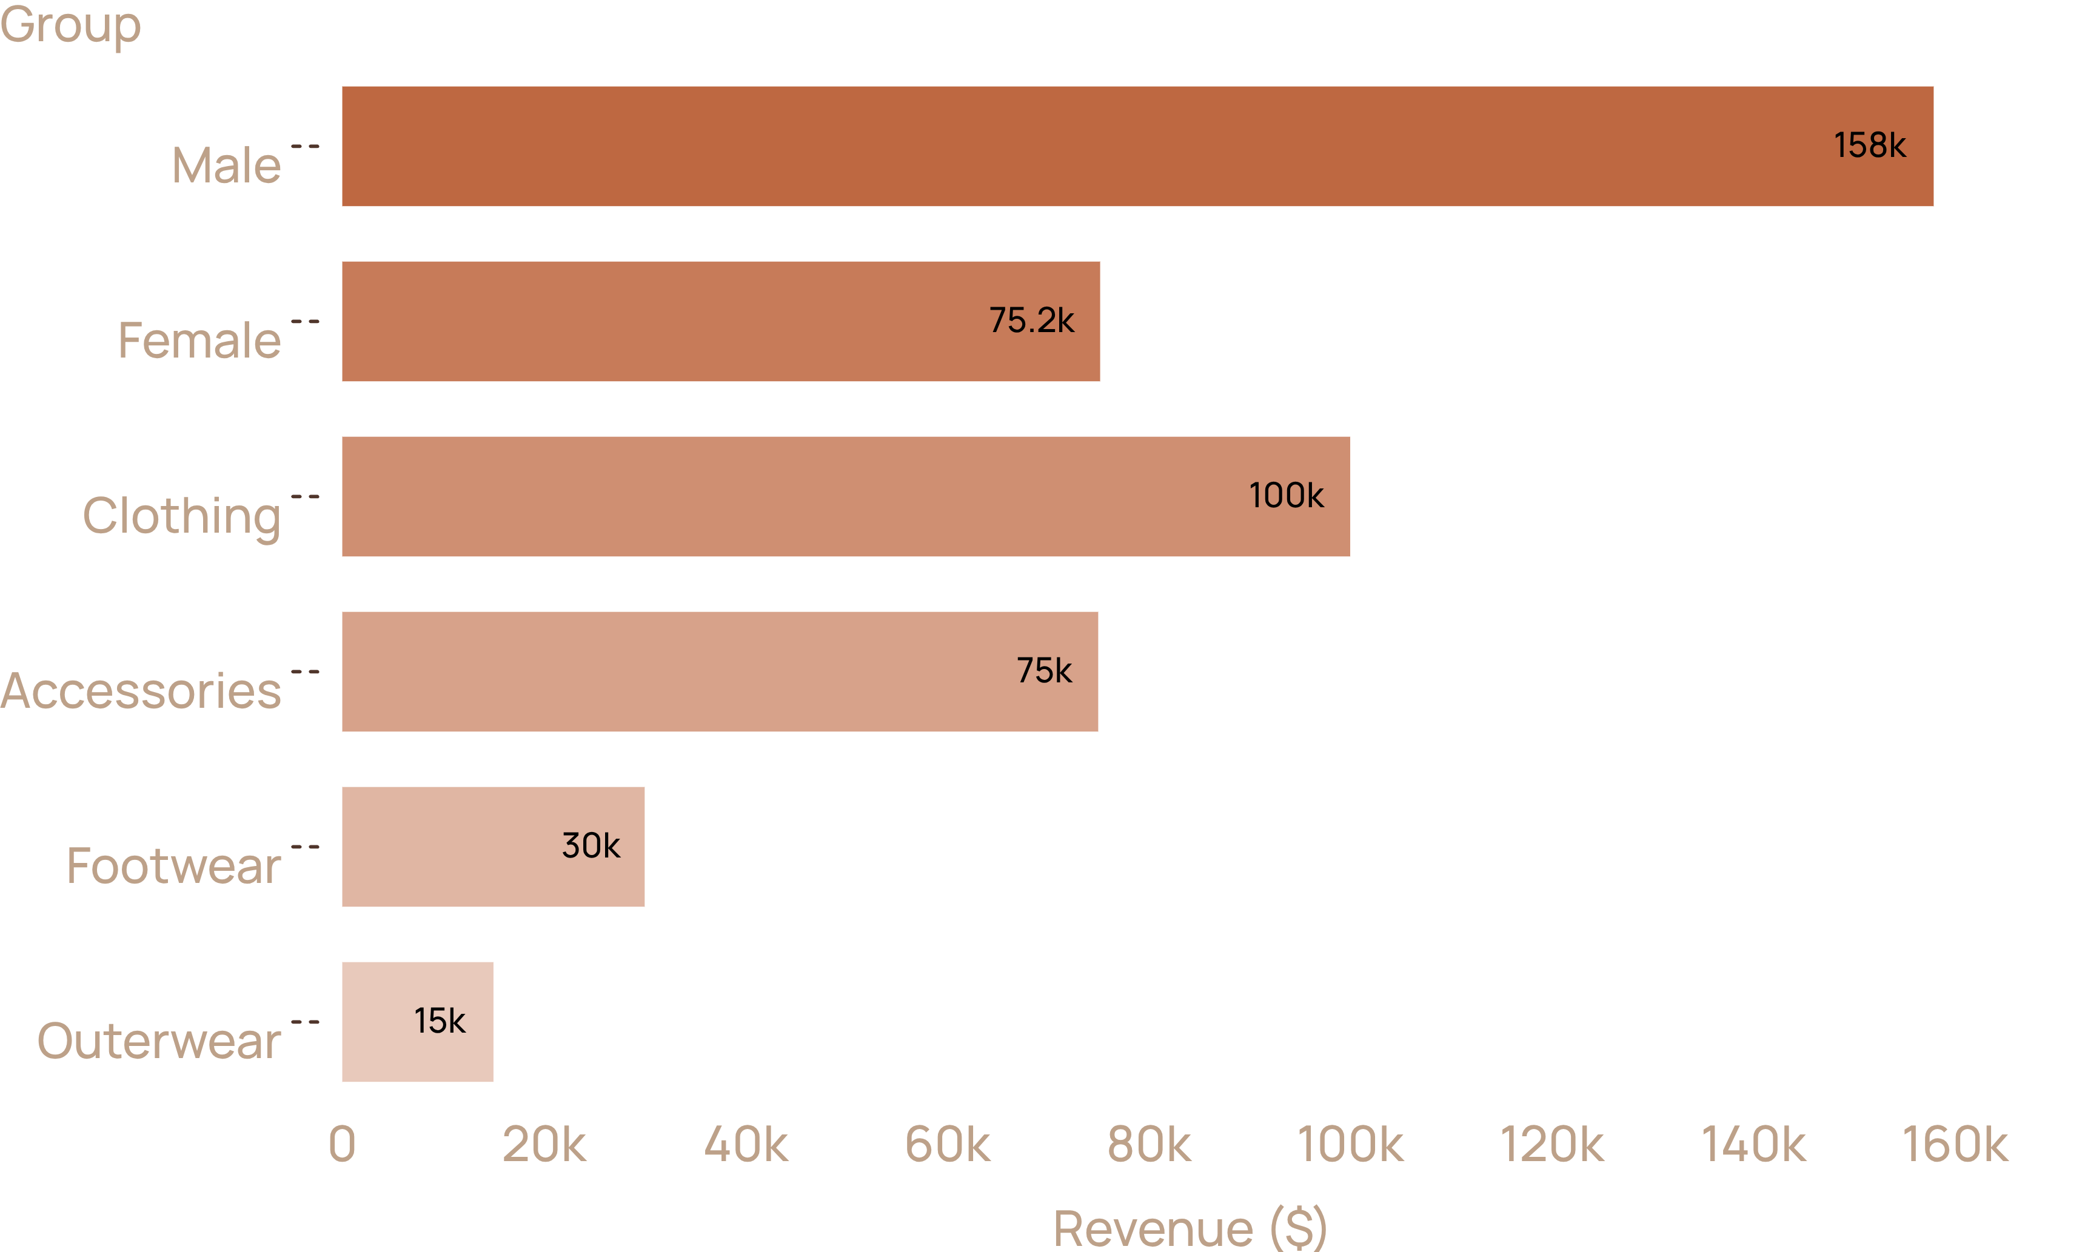
REVENUE MIX
Revenue is concentrated in clothing and male shoppers
Male customers generated $157,890 versus $75,191 from female customers. Clothing led category revenue at roughly $100K.

Slide 4
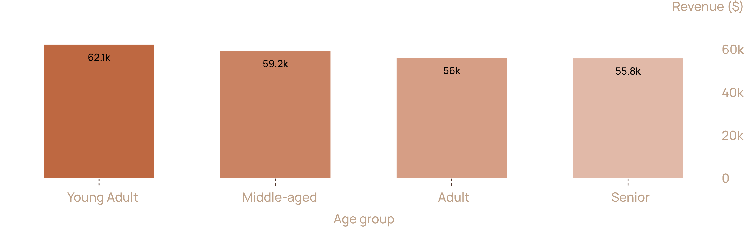
AGE MIX
Young adults lead revenue, but every age group matters
Young Adults contributed $62,143, followed by Middle-aged customers at $59,197, Adults at $55,978, and Seniors at $55,763.

Slide 5
PROMOTIONS
Discounts can drive volume without killing basket size
839
Top discount-dependent products
Watch the margin
Discount-led demand is strongest in a focused set of products.
customers used discounts and still spent above the average purchase amount.
Hat 50.00% · Sneakers 49.66% · Coat 49.07% · Sweater 48.17% · Pants 47.37%

Slide 6

PRODUCT SIGNALS
Product demand is broad, but a few items set the pace
Top-rated products: Gloves 3.86, Sandals 3.84, Boots 3.82, Hat 3.80, Skirt 3.78.
Signal | Products
Top-rated | Gloves, Sandals, Boots, Hat, Skirt
Accessories | Jewelry, Sunglasses, Belt
Clothing | Blouse, Pants, Shirt
Footwear | Sandals, Shoes, Sneakers
Outerwear | Jacket, Coat

Slide 7
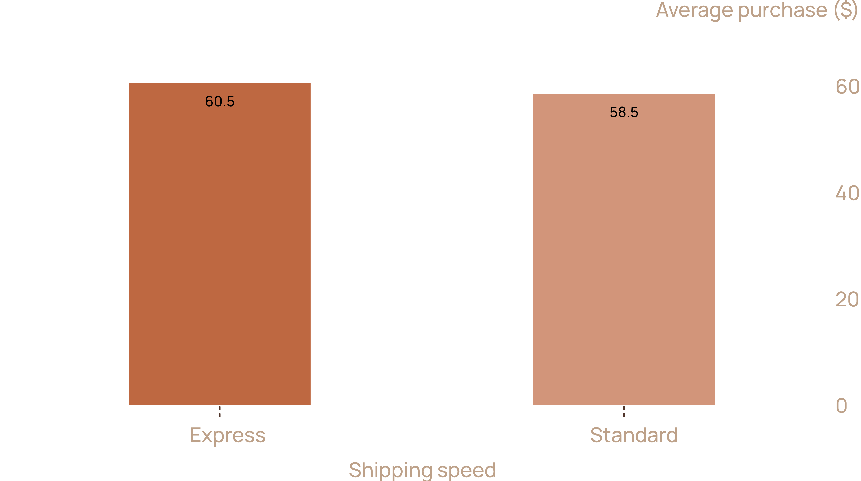
SHIPPING
Shipping speed adds value, but only at the margin
Speed may support a modest basket lift, so it belongs in targeted offers rather than blanket discounts.
Express average purchase: $60.48 · Standard average purchase: $58.46

Slide 8
SUBSCRIPTIONS
Subscriptions are the clearest growth gap
Subscribers generated $62,645 in total revenue at a $59.49 average spend. Non-subscribers generated $170,436 at $59.87.
Subscription status | Customers | Average spend | Total revenue
Yes | 1,053 | $59.49 | $62,645
No | 2,847 | $59.87 | $170,436
Do not sell “more spend”
Sell the benefit
Average spend is nearly flat.
Exclusive access, convenience, or rewards that convert an already-active base.

Slide 9
RETENTION ENGINE
Turn loyalty into a stronger retention engine
01
Boost subscriptions
Package exclusive benefits for the 2,847 non-subscribers.
02
Reward repeat buyers
Use loyalty mechanics to deepen the 701 Returning customers and protect the 3,116 Loyal customers.
03
Position proven products
Feature top-rated and category-leading items in campaigns.
04
Target by value
Focus on Young Adults, high-revenue categories, and Express-shipping users.

Slide 10
NEXT MOVE
Make the next purchase easier to choose
Lead with proven products, use discounts where they already convert, and give loyal non-subscribers a reason to join.

